Slide 1

Recognizing Faces in Recorded Video Using OpenCV and Face Recognition

Slide 2


FUNDAMENTALS OF COMPUTER VISION CS-4059 | SUBMITTED TO: Dr. Muhammad Farrukh Shahid mfarrukh.shahid@nu.edu.pk | SUBMITTED BY: Ayesha Ahmed Baig 20K-0172 Kanza Batool 20K-0423 Tahreem Fatima 20K-0482

Slide 3

Introduction
Load Known Faces
Select Video File
Open Video File Using OpenCV
Process Frames in the Video
Conclusion

Slide 4
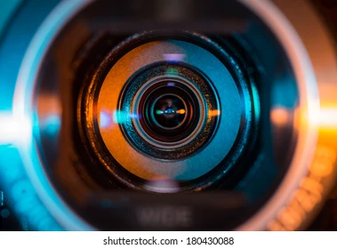
Introduction
Real-time video face recognition is a cutting-edge technology that has the potential to revolutionize the field of security and surveillance. With the help of OpenCV and face recognition libraries, it is now possible to detect and recognize faces in real-time video streams with high accuracy and speed.
In this presentation, we will discuss the implementation of a real-time video face recognition system using OpenCV and face recognition libraries. We will explain the code step-by-step and provide a detailed explanation of each component of the system.

Slide 5
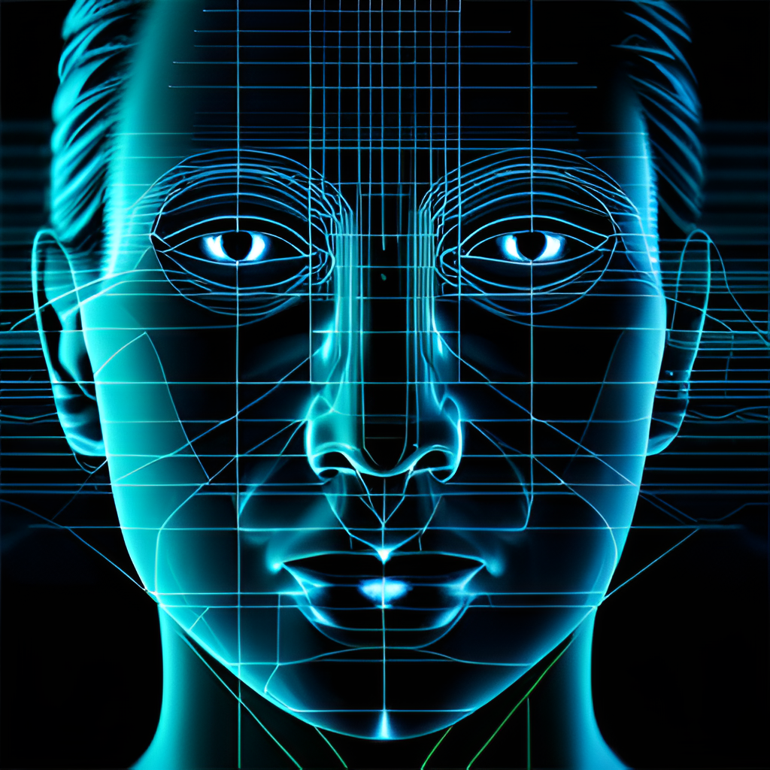
Load Known Faces
The first step in our real-time video face recognition system is to load the known faces. We do this by loading precomputed face encodings and corresponding names for each face from the encodings directory. The encodings are stored in a list called known_faces and the corresponding names are stored in a list called known_names.
This step is crucial as it allows the system to recognize known faces and compare them with the faces detected in the video stream. By storing the encodings and names beforehand, the system can quickly match detected faces with known faces and retrieve the corresponding name.

Slide 6

Select Video File
The next step in our real-time video face recognition system is to select a pre-recorded video file. We use tkinter to open a file dialog that allows the user to select a video file from their local machine.
Once the video file is selected, we use the VideoCapture method of the OpenCV library to open the selected video file. This step is important as it allows the system to process the frames in the video and detect faces in real-time.

Slide 7

Open Video File Using OpenCV
After selecting the video file, we use the VideoCapture method of the OpenCV library to open the selected video file. This method allows us to read the frames in the video and process them in real-time.
By opening the video file using OpenCV, we can access the individual frames in the video and apply various image processing techniques to detect faces and recognize them.

Slide 8

Process Frames in the Video
The next step in our real-time video face recognition system is to process the frames in the video. We loop through each frame in the video and convert it to grayscale using OpenCV.
We then use the Haar Cascade classifier to detect faces in the grayscale frame. For each detected face, we extract the face ROI (region of interest), resize it to 160x160 pixels, and compute the face encoding using the face recognition library. Finally, we compare the computed face encoding with the stored encodings of known faces to retrieve the corresponding name.

Slide 9

Conclusion
In conclusion, real-time video face recognition using OpenCV and face recognition libraries is a powerful technology that has numerous applications in the fields of security and surveillance. By following the steps outlined in this presentation, you can implement your own real-time video face recognition system and achieve high accuracy and speed.
We hope this presentation has provided you with a clear understanding of how to implement a real-time video face recognition system using OpenCV and face recognition libraries. Thank you for your attention.

